Slide 1
Department of Computer Science & Engineering
UE17CS355 – Web Tech II Laboratory
Project Evaluation
Project Title : Cogito – Marketing Campaign Solutions
Project Team : PES1201700016 Rashmi B
PES1201700674 Anirudh V
PES1201701129 Tejas Verma

Slide 2
Project Description
We present to you our website COGITO - Marketing Campaigning Solution Platform. Our website helps companies have a seamless planning and execution experience for their campaign. The industry standard features that we offer include blogs, idea pitching area, planning an event. We basically help companies with their digital marketing domain.
Since digital marketing is the only way to reach an enormous crowd in the most cost effective and measurable way, this makes our services very much in demand among companies who want a J curve in their businesses or are having problems in expanding their business or are having problems in increasing their customer base. Having the highest market share, its the thing every business needs to survive in this day and age. We help our customers with the complete view, with the present market scenario, potential market cap, net worthy events to take action on , and get them the correct leads and contacts.
Thus using our platform, we help understand customer preference and help them by giving them personalized communication, thus ensuring efficient business process management. We realize that customer needs a fluid and seamless engagement while managing campaigns across email, social, mobile, web and other channels while to create an engaging experience. Our platform thus helps in the orchestrating cross channel marketing initiatives to reach the maximum demographics by carefully involving steps of planning, measurement, and final execution. Thus because of our vast previous experience , we help businesses amplify their marketing game.

Slide 3
Technologies Used
Front-end Framework : AngularJs
Back-end Framework : Django
Structure of the page : HTML (Hypertext Markup Language)
Visual and Aural layout : CSS (Cascading Style Sheets)
Client-side Scripting Language : AJAX (Asynchronous Javascript and XML)
Scripting Interface : XMLHttpRequest
Server-side Scripting Language : PHP and Django
Python Modules Used : pandas, wordCloud, langdetect, etc.,

Slide 4
Techniques Implemented
Multistage Download :
Multistage download is an Ajax pattern wherein only the most basic functionality is loaded into a page initially. Upon completion, the page then begins to download other components that should appear on the page.
In our project, we have web pages which tells the user about the various services we are providing. We have used images with embedded text to do so, this makes the page interactive and appealing to the user. When the user visits the page the basic content is loaded, which initially shows the image of one of our services, and if the user stays on the page for an extended period of time, the images of other services are also loaded and displayed. The user can enjoy our services by just clicking on any one of these images.

Slide 5
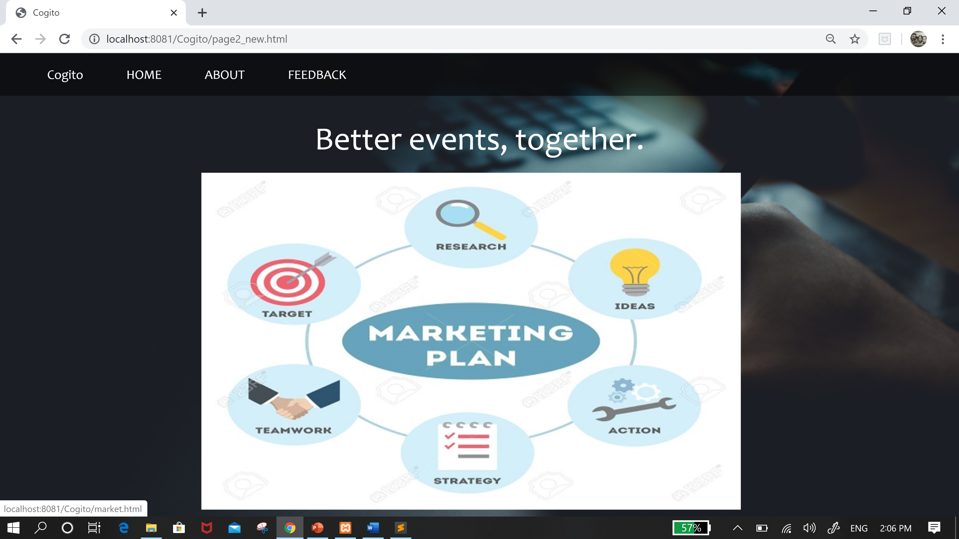
Techniques Implemented
Multistage Download Home page :

Slide 6
Techniques Implemented
The Hidden Frame Technique :
The basic idea behind this technique is to create a frameset that has a hidden frame that is used for client-server communication.
Our website has an “About” page which gives details about “Cogito” , with customer reviews. Intrigued users can through this page to find out more about the website and refer to the customers’ reviews before they consider us as their marketing consultant. On this page initially not all the comments are loaded, if the user wants to read more reviews, he can do so by just a click. So when the request for more comments is made, the new comments are fetched from the database and displayed without reloading the page. This communication is happening via hidden frames technique.
We are using hidden frames technique to communicate between the client and server on our feedback page also, which collects the reviews of our customers and notifies the user after successfully storing the feedback in database without reloading the page.

Slide 7
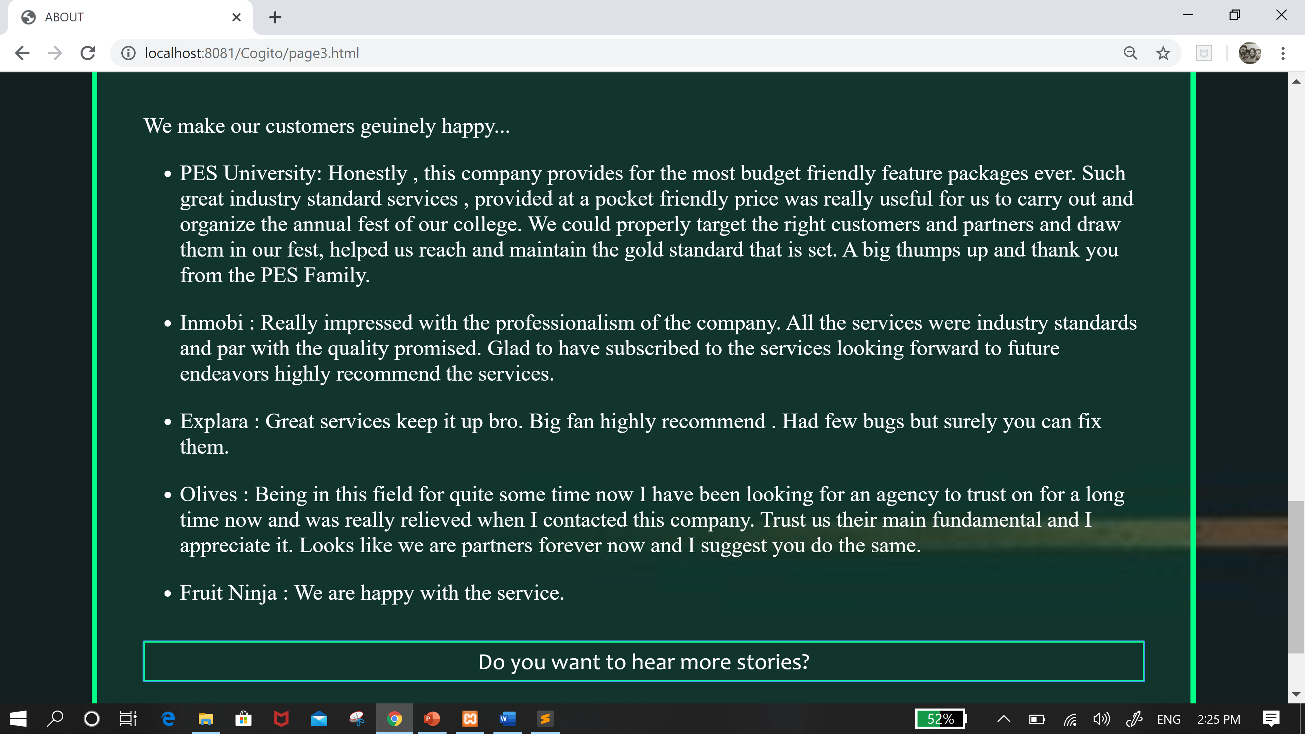
Techniques Implemented
The Hidden Frame Technique About page :

Slide 8
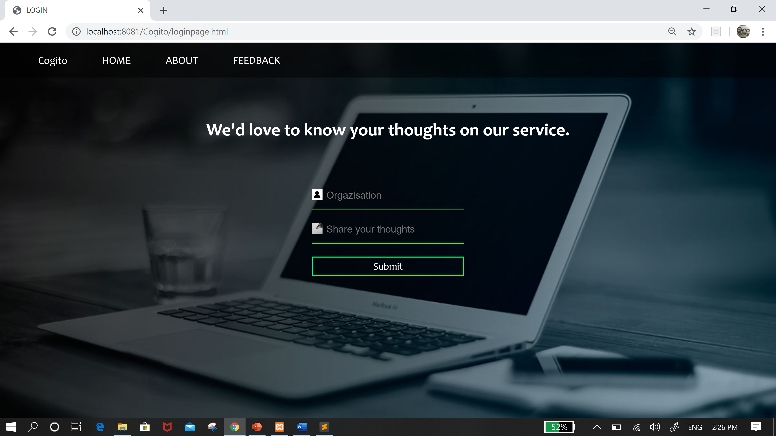
Techniques Implemented
The Hidden Frame Technique Feedback Page :

Slide 9
Techniques Implemented
RSS(Really Simple Syndication) :
Websites usually use RSS feeds to publish frequently updated information, such as blog entries, news headlines, or episodes of audio and video series. RSS is also used to distribute podcasts.
One of the best aspects of our website is that, we are linked to a lot of blogs and we are using RSS feeds to do so.
How does this help us?
SEO ( Search Engine Optimization) is a methodology of strategies, techniques and tactics used to increase the amount of visitors (traffic) to a website by obtaining a high-ranking placement in the search results page of a search engine (SERP) — including Google, Bing, Yahoo and other search engines. Using RSS feeds for publishing the blogs that have periodically changing content on our website, would boost stats on google Analytics page, and thus increases the visitors to our website.

Slide 10
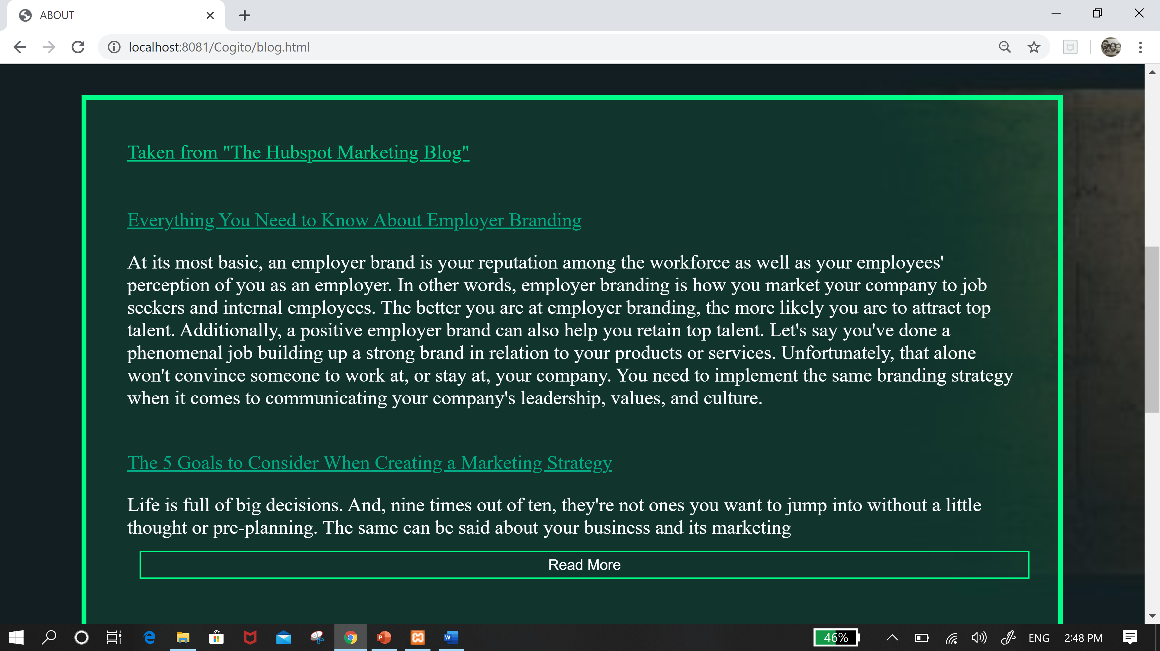
Techniques Implemented
RSS(Really Simple Syndication) Blogs :

Slide 11
Techniques Implemented
SSE (Server Sent Events) :
Server-sent DOM events allow a server to stream data to the client, which fires events in response to that data, allowing developers easy access to server information. Essentially, the browser opens a persistent connection to a particular page on the server and listens for new data coming in.
Our website offers a platform to the customers, where they can interact with our team to pitch their ideas, organize an event, plan campaigns, for advice, set up a meeting etc., and SSE is an apt technique to build this feature.

Slide 12
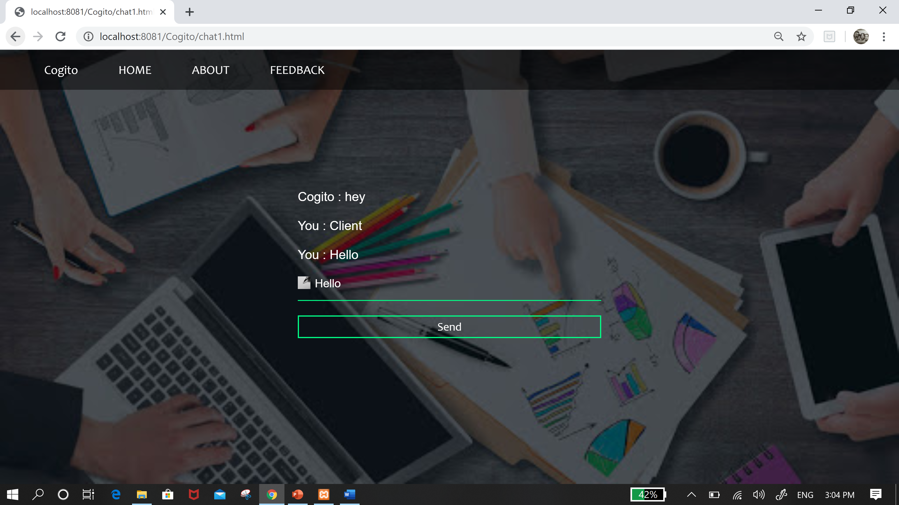
Techniques Implemented
SSE (Server Sent Events) :

Slide 13
Intelligent Functionality
CLUSTER-DISCOVERY OF TWITTER MESSAGES FOR EVENT DETECTION AND TRENDING
Social media data carries abundant, hidden occurrences of real-time events. Our method is used for detecting trending events from tweet clusters that are discovered by using locality sensitive hashing (LSH) technique. These detected events are used by our website, to recommend the companies to sponsor these events, so that in return they get recognized. Refer to the next slide for system architecture.

Slide 14
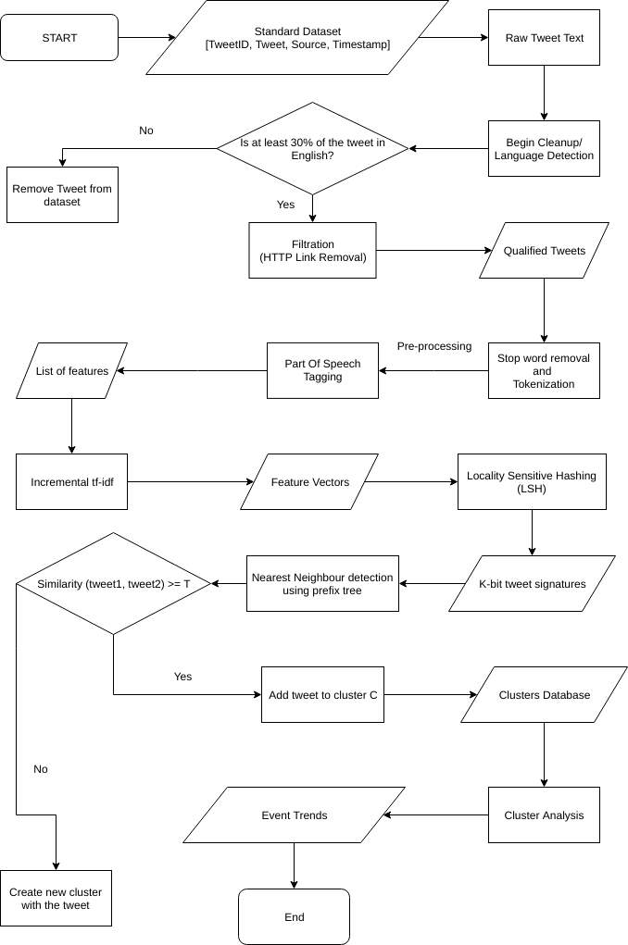
Intelligent Functionality-Cluster discovery of twitter messages for event detection and trending

Slide 15
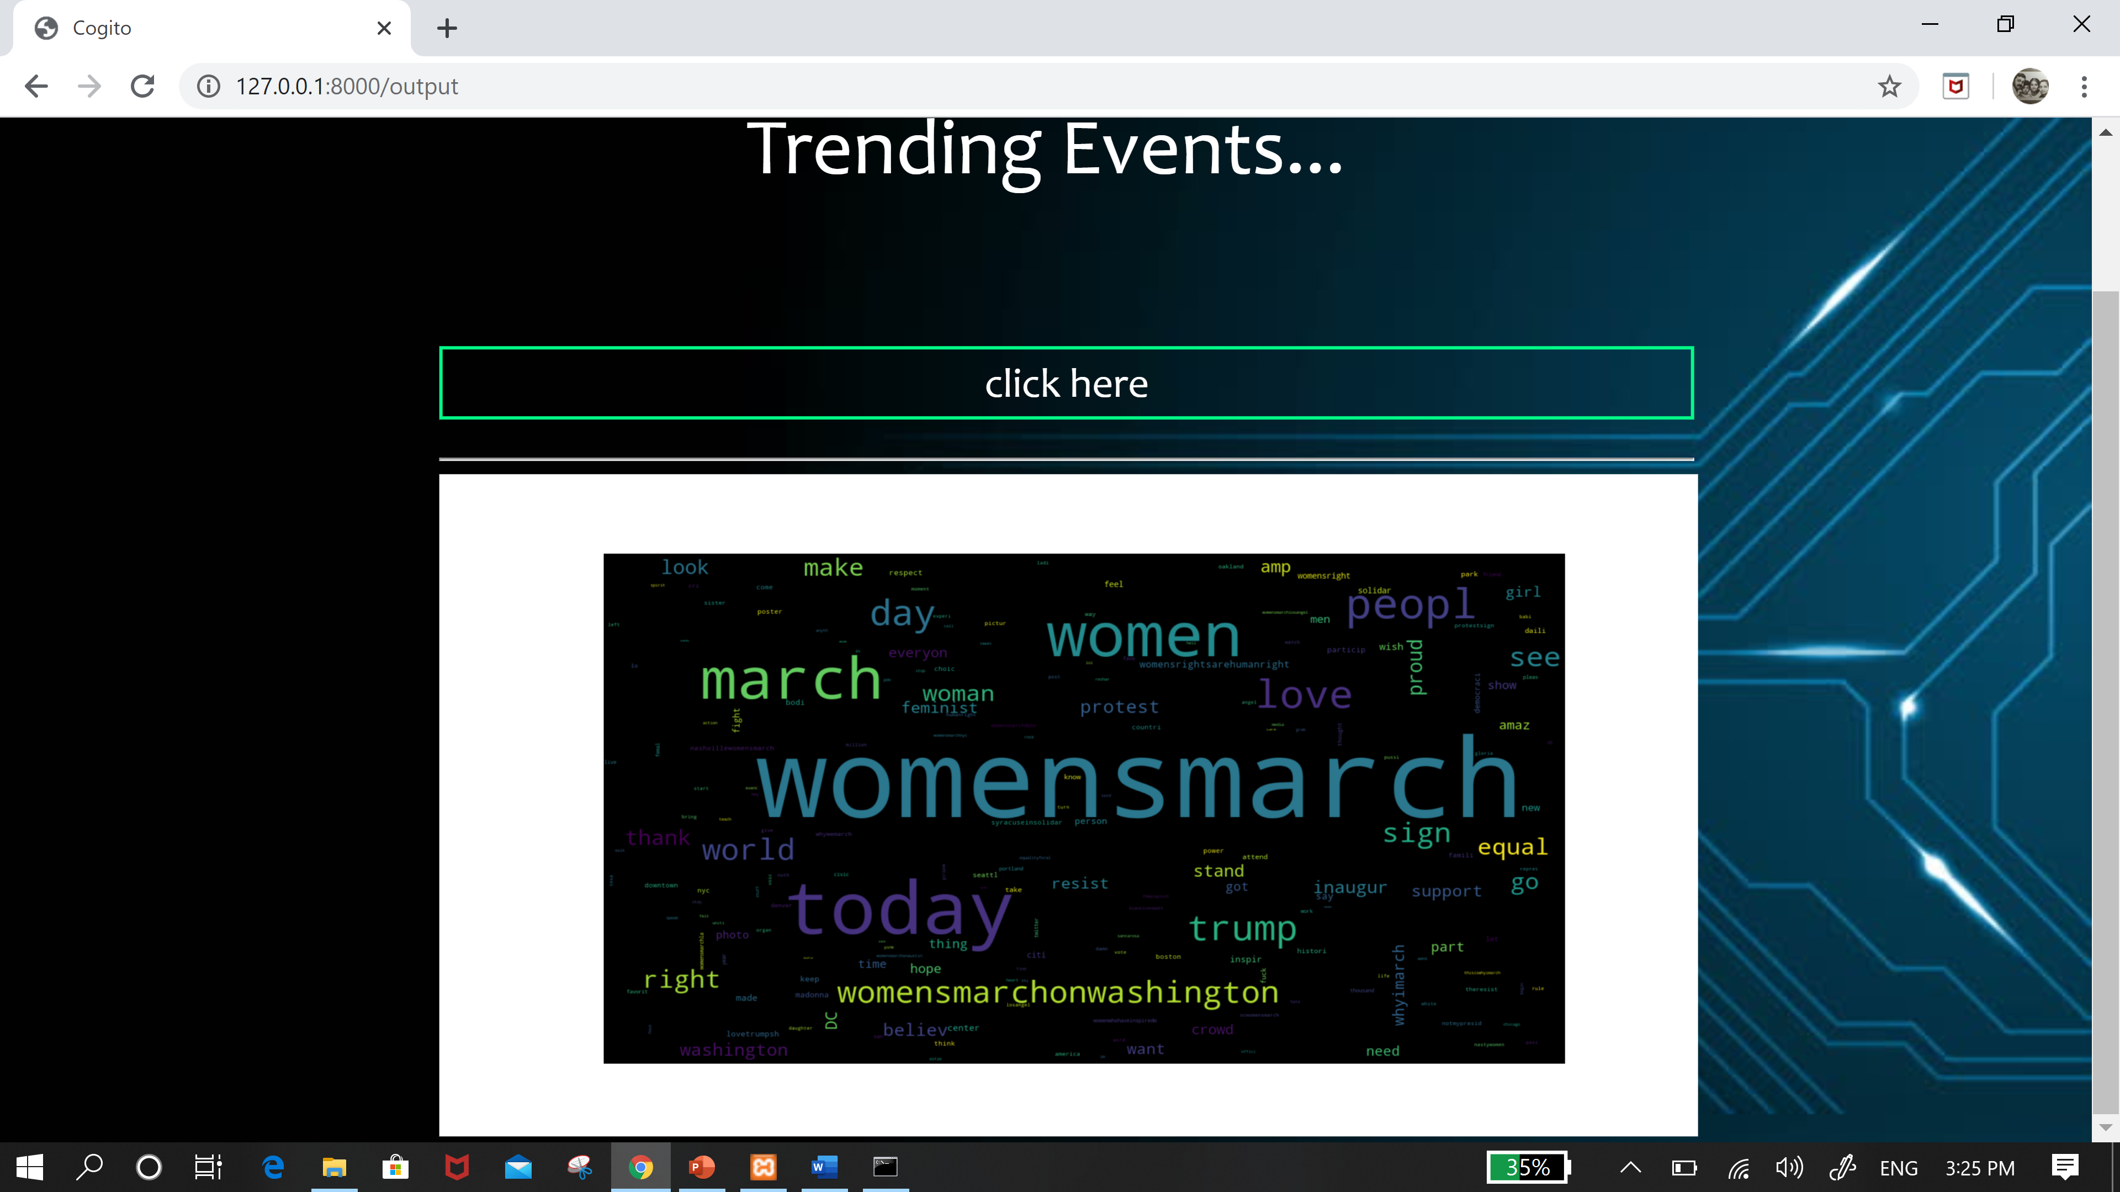
Intelligent Functionality
CLUSTER-DISCOVERY OF TWITTER MESSAGES FOR EVENT DETECTION AND TRENDING

Slide 16
Intelligent Functionality
K means Clustering :
Kmeans algorithm is an iterative algorithm that tries to partition the dataset into Kpre-defined distinct non-overlapping subgroups (clusters) where each data point belongs to only one group. It tries to make the inter-cluster data points as similar as possible while also keeping the clusters as different (far) as possible. It assigns data points to a cluster such that the sum of the squared distance between the data points and the cluster’s centroid (arithmetic mean of all the data points that belong to that cluster) is at the minimum. The less variation we have within clusters, the more homogeneous (similar) the data points are within the same cluster.
Our website offers a solution to all the schools and college events for campaigning. Collecting the database for campaigning, setting up appointments and co-ordination of the campaign team is a tedious job. Our website makes this task simple. With the help of K-means we cluster all the schools that are closer to each other in an area and we suggest which school to start with, so that the campaign team will not only save time in planning, but also in travelling.

Slide 17
Intelligent Functionality
K means Clustering Algorithm :
K centroids are created randomly (based on the predefined value of K).
K-means allocates every data point in the dataset to the nearest centroid (minimizing Euclidean distances between them), meaning that a data point is considered to be in a particular cluster if it is closer to that cluster’s centroid than any other centroid.
Then K-means recalculates the centroids by taking the mean of all data points assigned to that centroid’s cluster, hence reducing the total intra-cluster variance in relation to the previous step. The “means” in the K-means refers to averaging the data and finding the new centroid.
The algorithm iterates between steps 2 and 3 until some criteria is met (e.g. the sum of distances between the data points and their corresponding centroid is minimized, a maximum number of iterations is reached, no changes in centroids value or no data points change clusters).

Slide 18
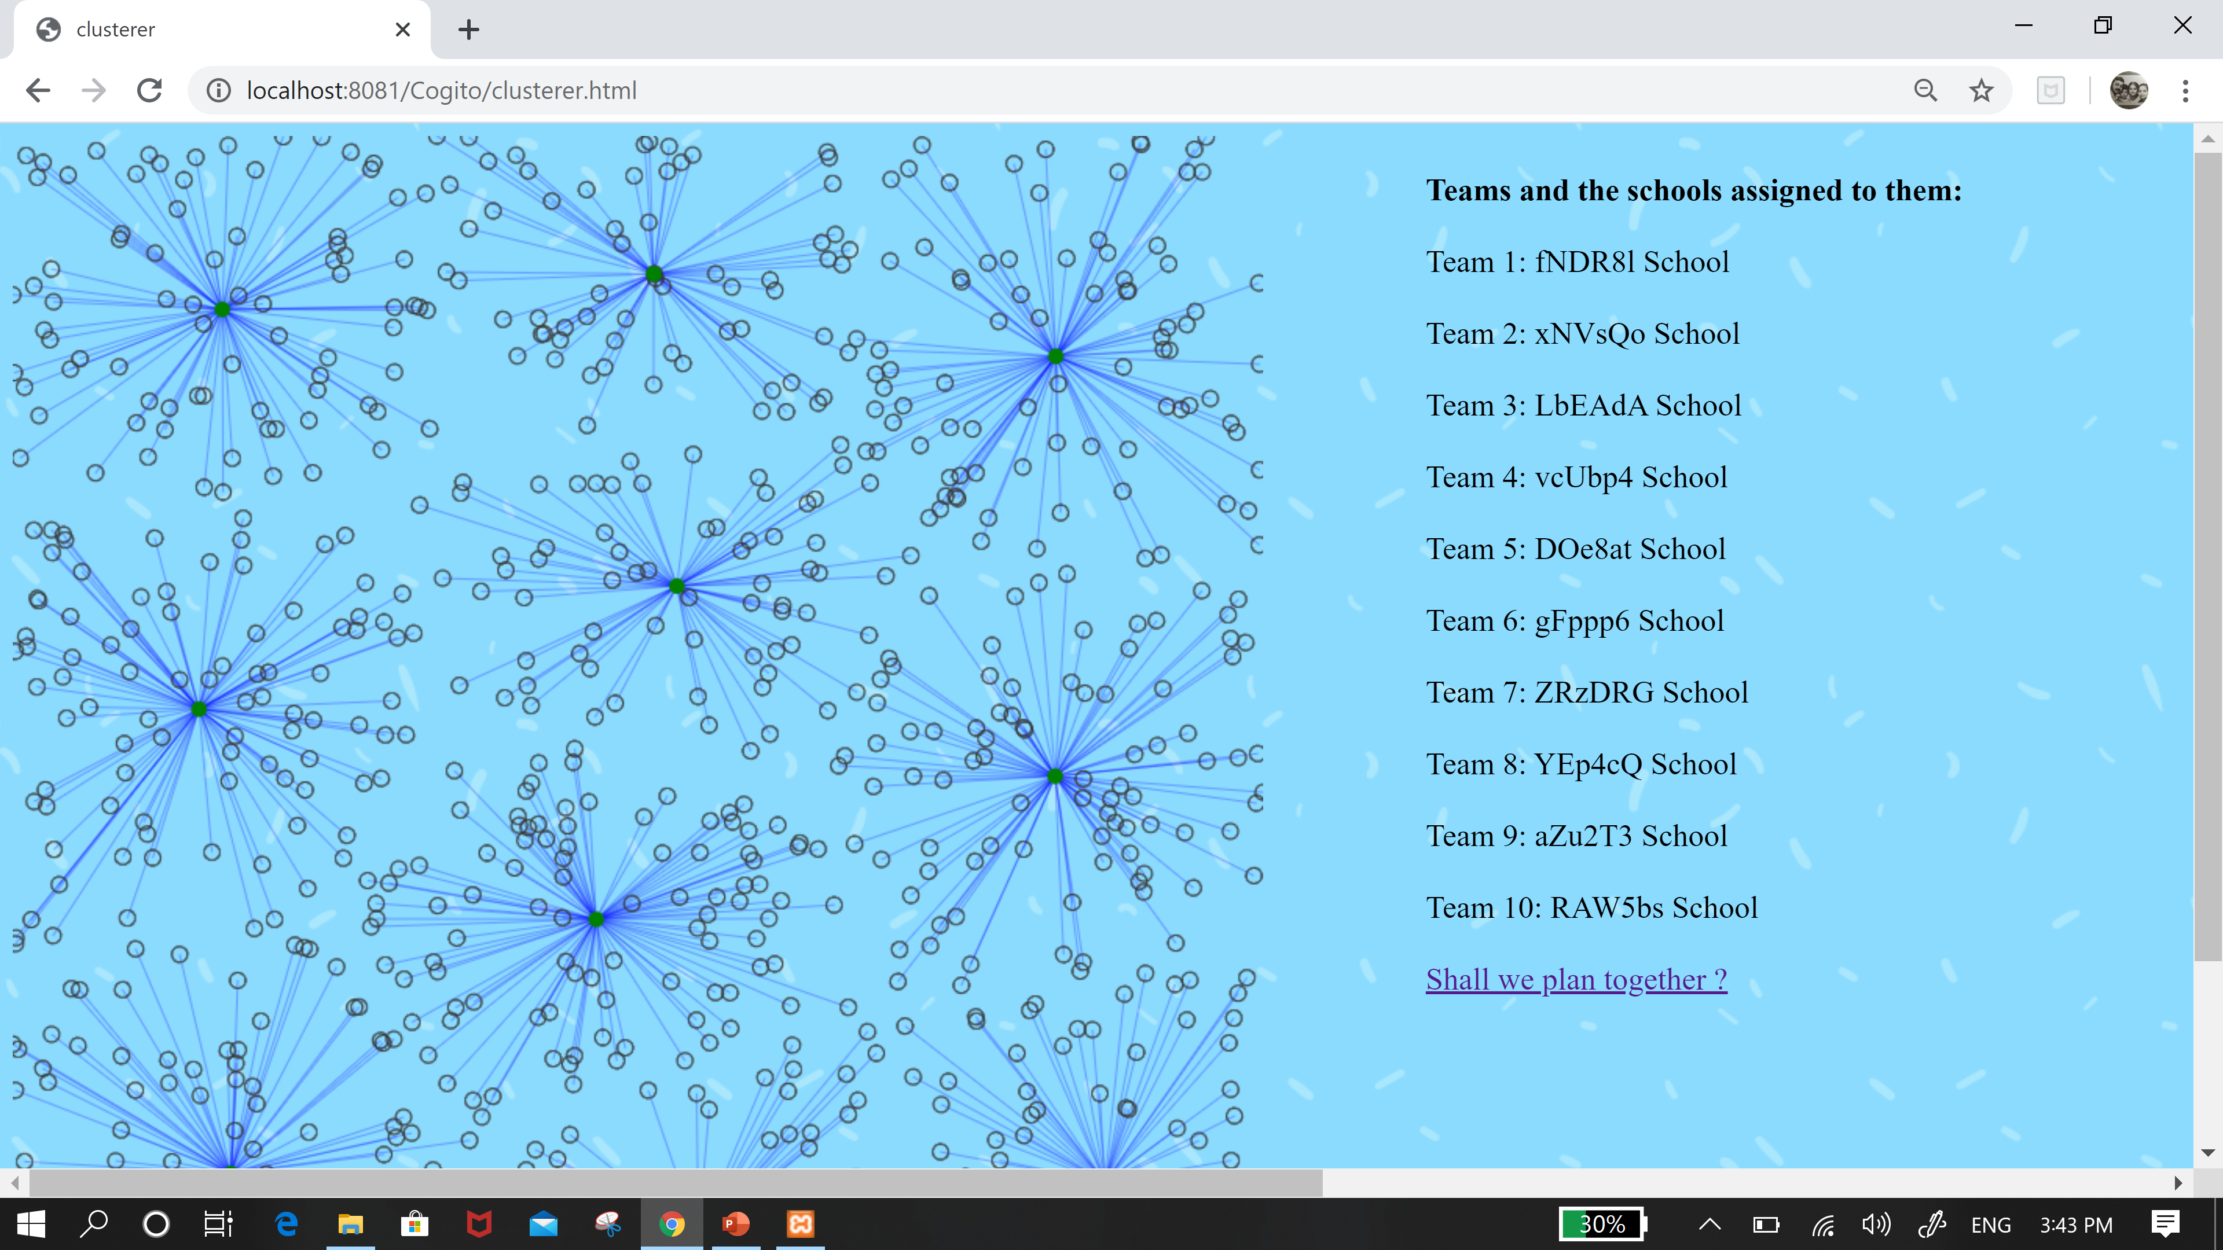
Intelligent Functionality
K means Clustering :

Slide 19
Intelligent Functionality
Contextual Semantic Search :
Contextual Semantic Search is categorizing texts based on keywords. Our website uses this technique to categorize customer reviews as positive and negative. Labelling the feedback is necessary for us. When a new user requests for customer reviews we show only positive reviews. The negative reviews are for us to work on our methods to give better services to our customers.

Slide 20
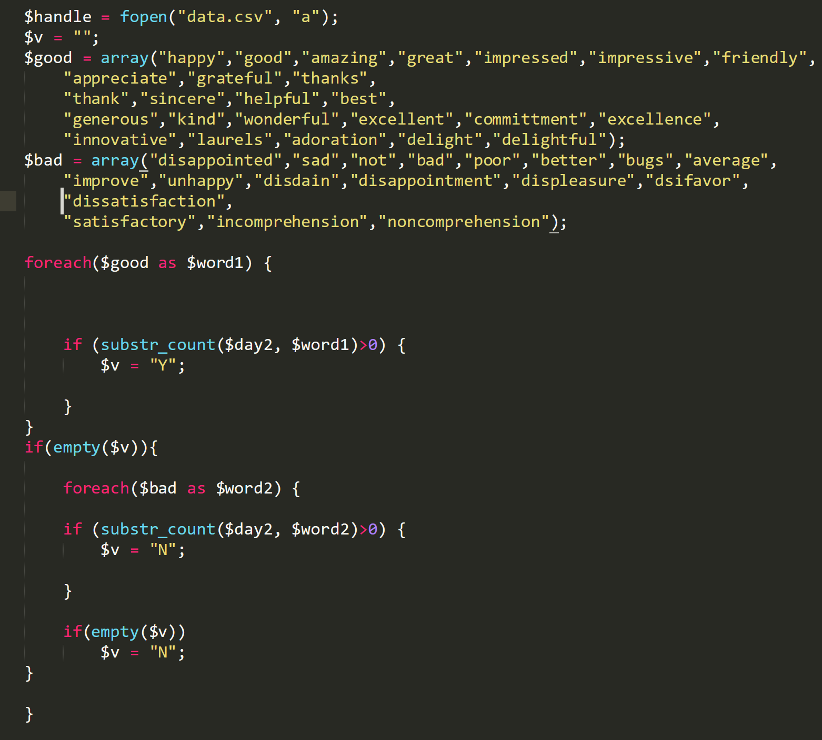
Intelligent Functionality
Contextual Semantic Search : Implementation – here y is positive; n is negative;

Slide 21
Thank You

